Slide 1

HEAD START
CHAPTER -2
DOMAIN : PYTHON

Slide 2
GROUP MEMBERS
Naheed khanum
Electrical and electronics engineering.
1604-19-734-004
Rabaab fatima
Electrical and electronics engineering.
1604-19-734-032
Maleeha nurain
Electrical and electronics engineering
1604-19-734-003

Slide 3
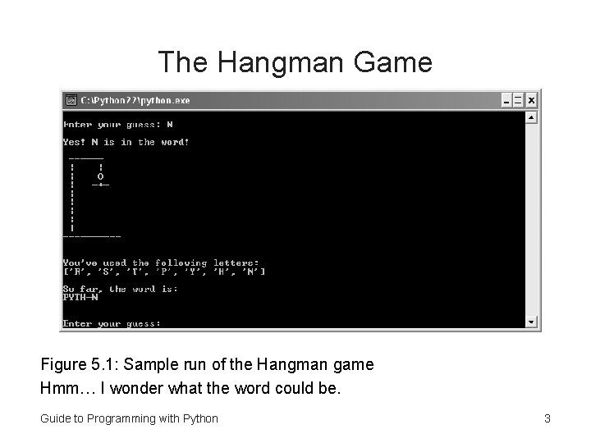
Project -1

Slide 4
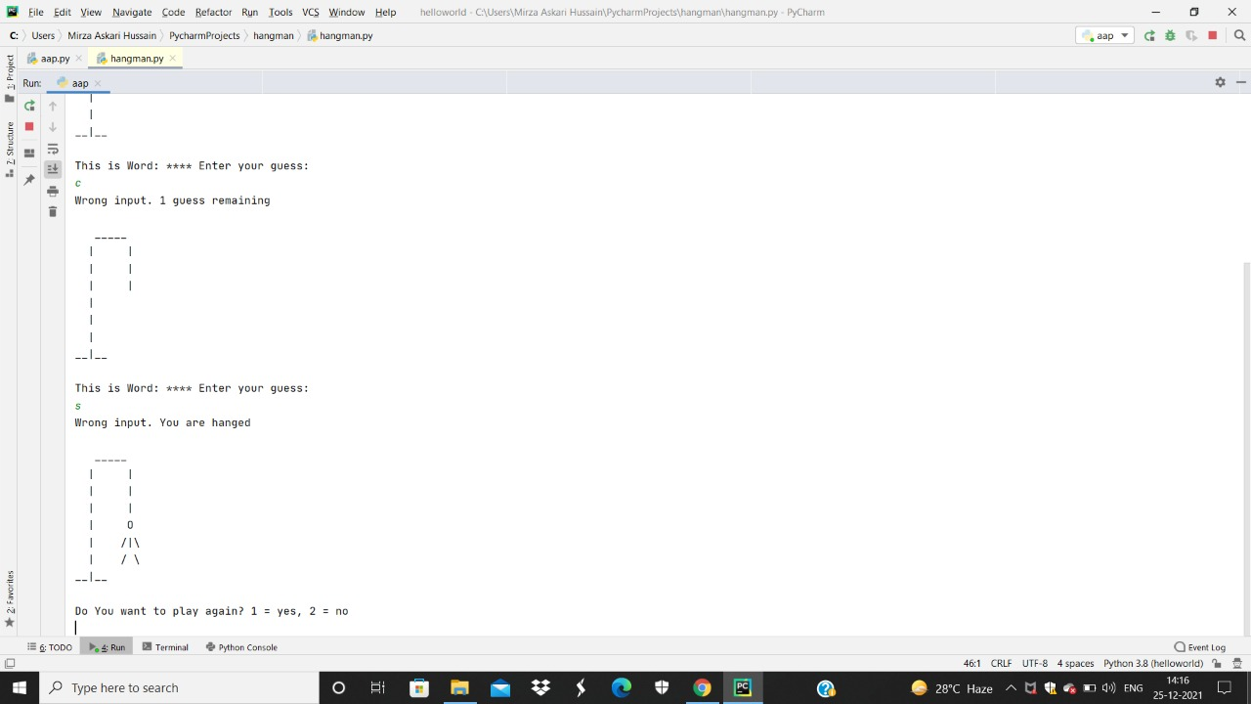
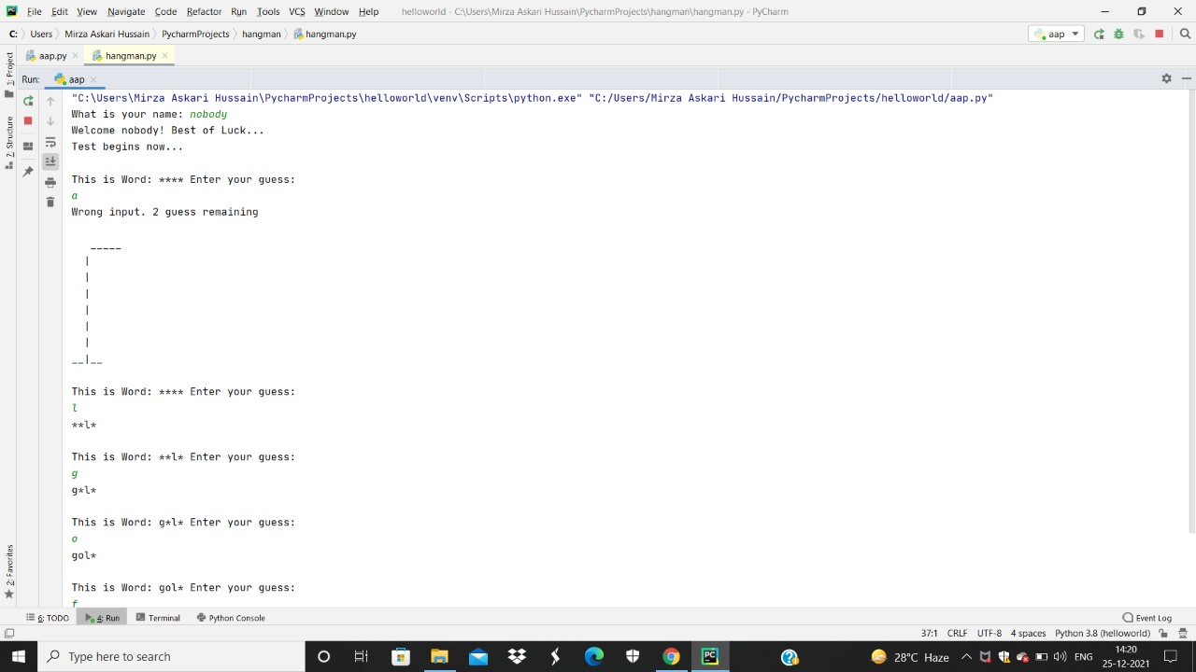
The outcome of the project:

Slide 5
References
App: python
Courses: www.youtube.com
www.w3schools.com

Slide 6

THANK YOU

